Slide 1

House Price Prediction Analysis
DATA 606 Capstone in Data Science
Chaoji Wang
By
Pavani Velma

Slide 2
Introduction
Real estate is a crucial sector of the economy.
Prices of real estate properties such as houses are liked to various factors such as population growth, unemployment, GDP and GNI.
Accurately estimating the price of houses is essential for a variety of purposes, including buying, selling, investing, and financing.

Slide 3
Problem statement
The objective of this project is to
To apply data preprocessing and preparation techniques in order to obtain clean data.
To build machine learning models able to predict house price based on house features
To analyze and compare models performance in order to choose the best model

Slide 4
Agenda
Understanding of dataset and features.
Data preparation, cleaning, and outlier analysis.
Exploratory data analysis and insight generation.
Feature selection and machine learning modelling.

Slide 5
Dataset
I am using a dataset that has historical date of houses sold in different counties, states in USA across multiple years starting from 1996 to 2020.
Features | Description
Average Price | Average price of a house in a region and year
Beds | Number of beds in a house
County Name | County in which a house is sold
State | State in which a house is sold
Metro | Metro in which a house is sold
Size rank | Size rank of a city
Year | Year in which a house is sold

Slide 6
Data Cleaning and preparation
Merged multiple datasets.
Calculated monthly house price into yearly avg price.
Removed redundant columns.
Removed rows with null values.

Slide 7
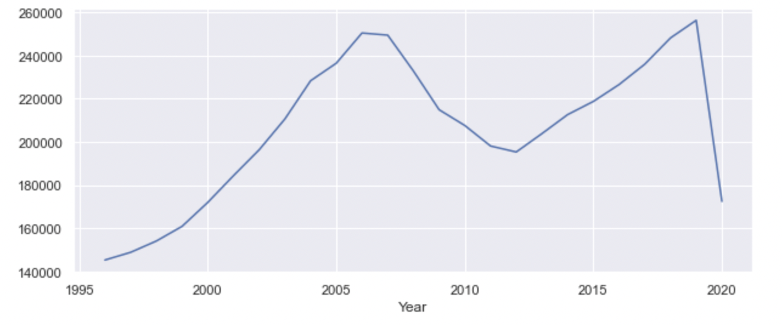
Average housing prices
From 2006 to 2012 Average price gradually decreased.
From 2012 Average price increased and peaked at 2019.
Due to Covid-19, avg prices again decreased.

Slide 8
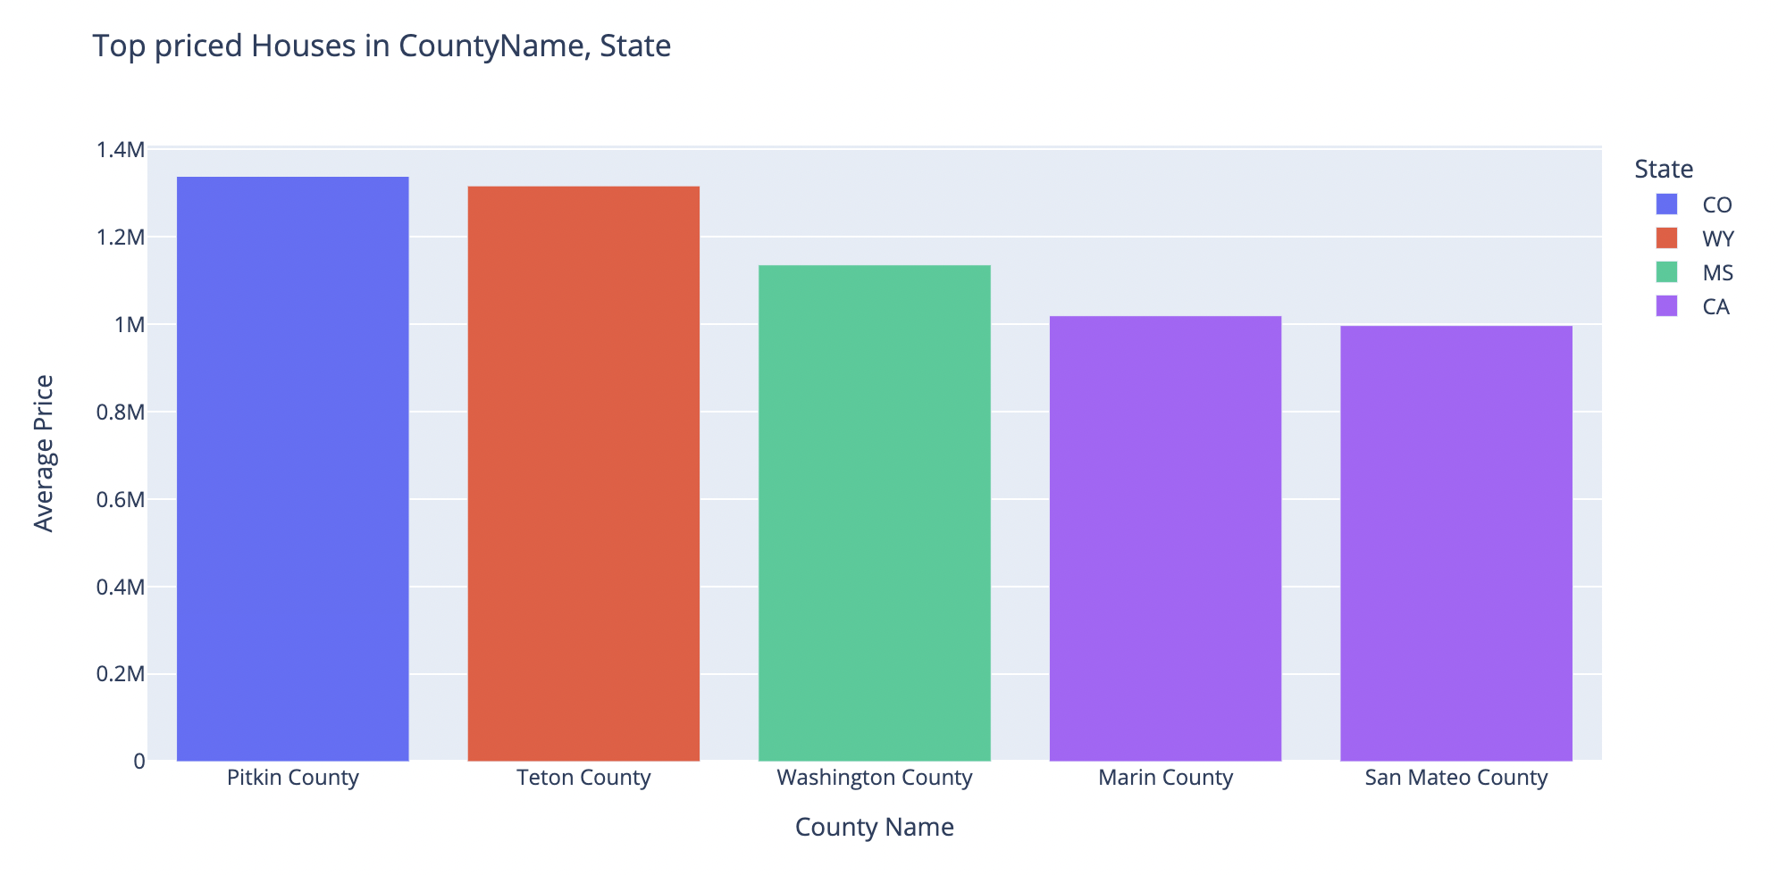
top five counties with highest average price
Pitkin county, Colorado, has highest avg house prices since 1996.
San Mateo county, California, has lowest avg house prices since 1996.

Slide 9
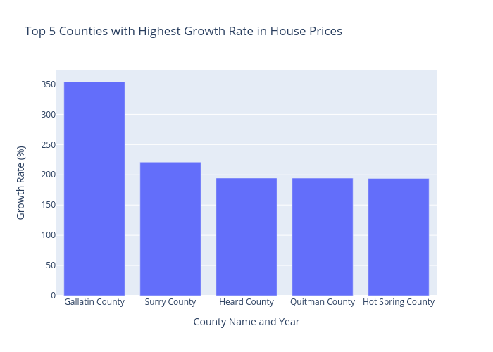
top five counties with highest growth rate
Gallatin County, Montana, has highest growth rate. House prices in Gallatin County has increased 350 times since 1996.
Heard, Quitman, Hot Spring Counties have similar growth rate.

Slide 10
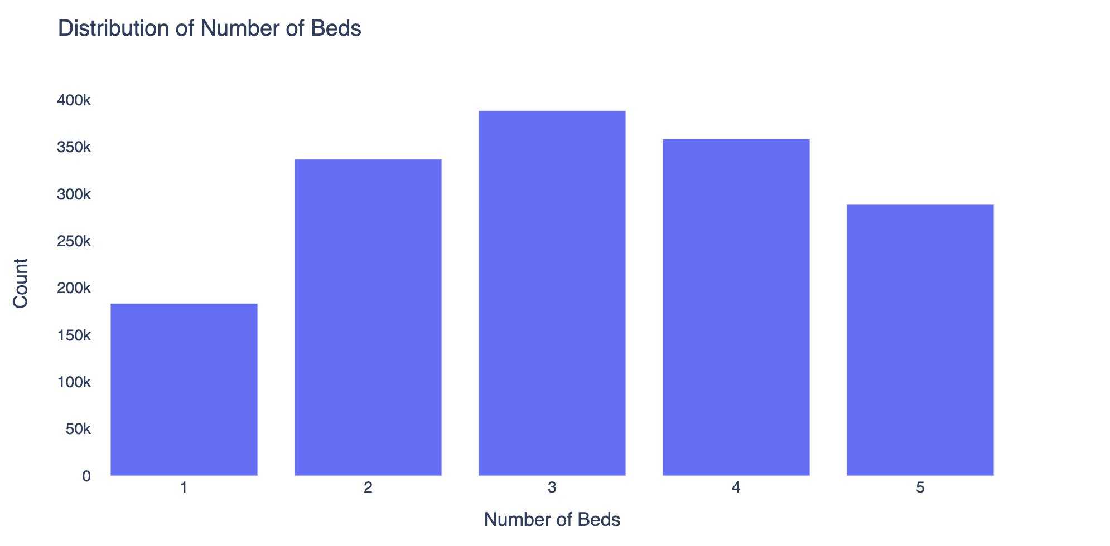
Distribution of nO.of beds
Highest number of houses in USA has 3 bedrooms.
Houses with single bedroom are low in count.

Slide 11
Feature Selection
Used select k- best method for feature selection.
This method used various statistical test to determine the best features which can be used for model building.

Slide 12
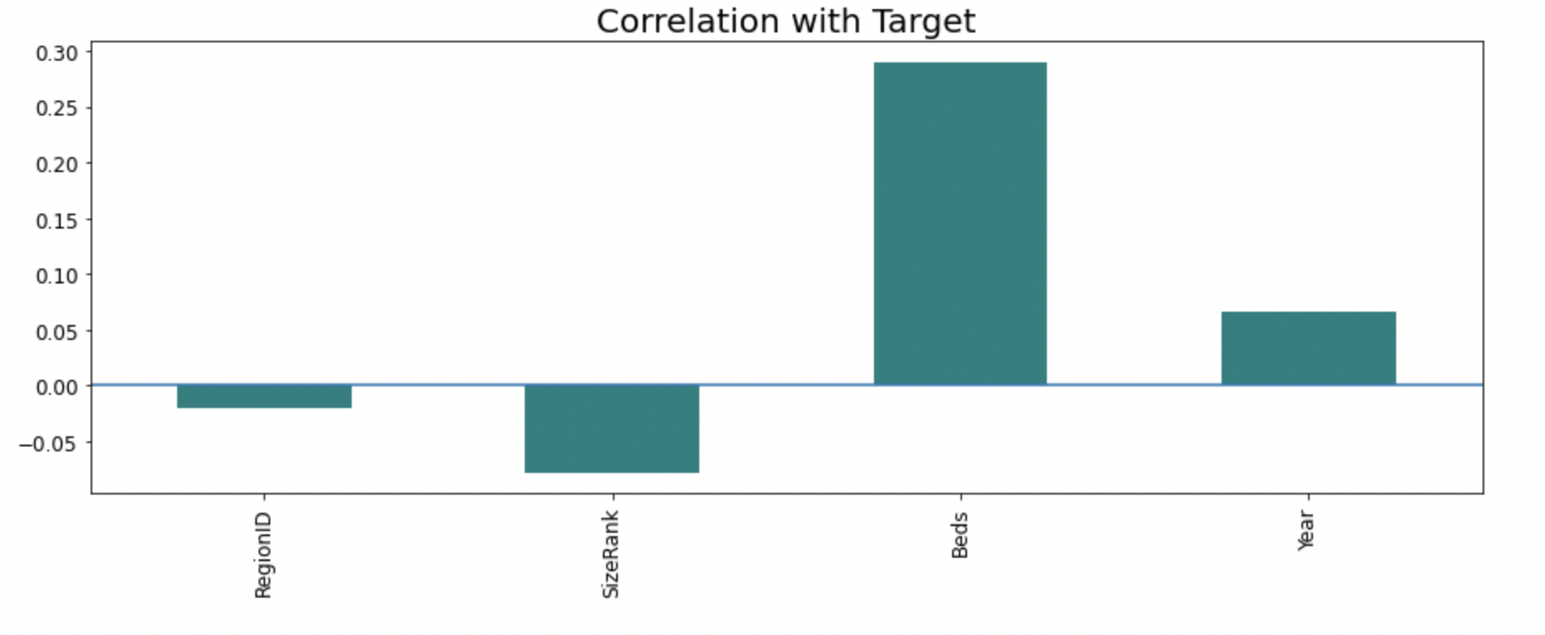
Correlation with target
Beds and avg price are highly and positively correlated that means higher the no.of beds higher the price of the house
Size rank is negatively correlated. Lowest size rank has highest price.

Slide 13
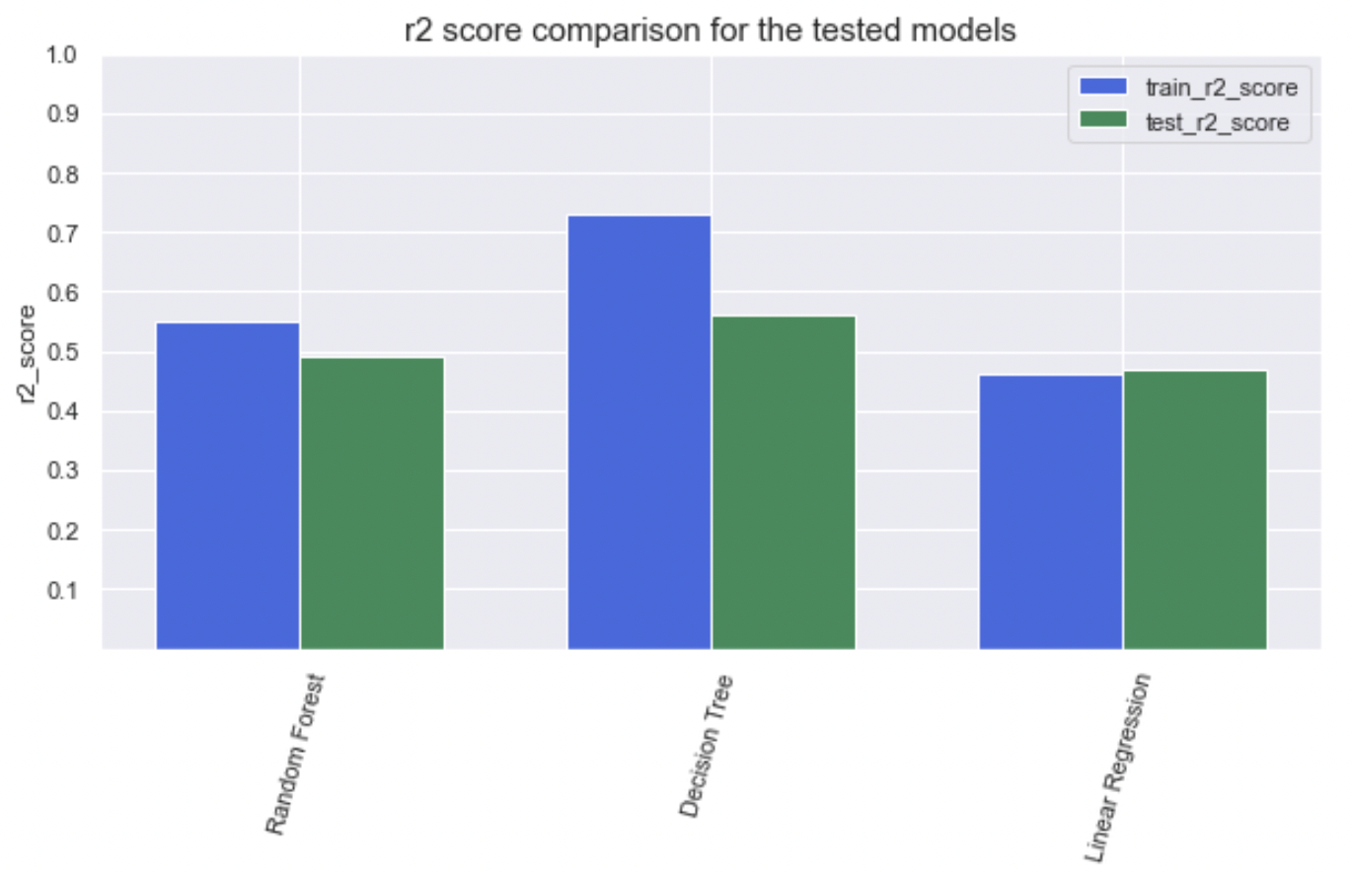
Model Building
Used the following machine learning models to predict the house prices.
Linear Regression.
Decision Tree Regressor.
Random Forest Regressor.

Slide 14
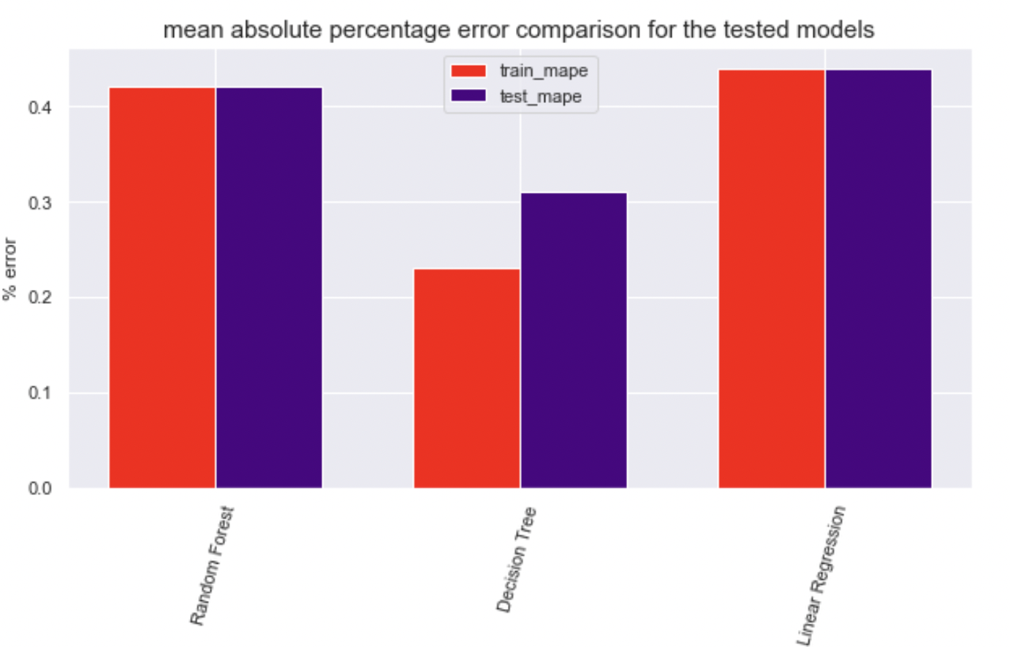
mean absolute percentage error comparison for the tested models

Slide 15
Comparison of model performance
Model | Train mae | Test mae | Train mape | Test mape | Train r2 | Test r2
Linear Regression | 80744.64 | 80032.45 | 0.44 | 0.44 | 0.46 | 0.47
Random Forest | 76298.60 | 78771.43 | 0.42 | 0.42 | 0.55 | 0.49
Decision Tree | 49884.22 | 65227.71 | 0.23 | 0.31 | 0.73 | 0.56

Slide 16

Thank you

